Slide 1
NoSQL Databases
Part - 1
Mr. Hemanga Gautam
hemanga.gautam@heraldcollege.edu.np

Slide 2
Outlines
Data Models
Semi, Structured and Unstructured data
Types of NoSQL Databases
MongoDB

Slide 3
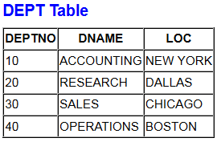
Data Models
Data models define how the logical structure of a database is modeled.
Data Models are fundamental entities to introduce abstraction in a DBMS.
Data models define how data is connected to each other and how they are processed and stored inside the system.
For example, Oracle is based on the relational model and data is stored in a tabular format:

Slide 4
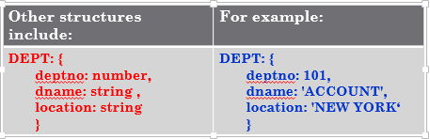

Slide 5
Structured Data

Slide 6
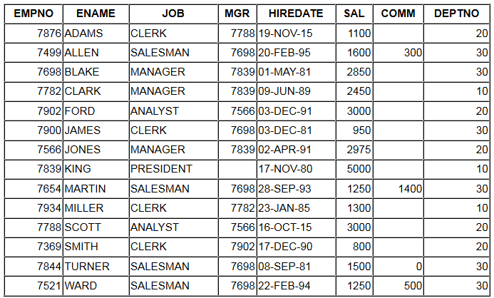
Data Models – Structured data
Structured data is data that adheres to a pre-defined data model and is therefore straightforward to analyse.
Shows relationship between the different rows and columns.
Common examples of structured data are: Excel files or SQL databases
All rows in both tables follow the same structure
All columns have the same data type

Slide 7
Data Models – Semi-Structured data
Not all records have the same structure
Not all data can conform to a structured model.
What if the data for our DEPT table looked like this:
DEPT: { deptno: 10, dname: 'ACCOUNTING', loc: 'NEW YORK‘, auditor: ‘Rajan’ } | DEPT: { deptno: 30, dname: ‘SALES', loc: ‘CHICAGO‘, budget: 50,000 }
DEPT: { deptno: 20, dname: RESEARCH', loc: ‘DALLAS‘, prof: ‘Prof Green’, status: ‘Silver’ } | DEPT: { deptno: 40, dname: ‘OPERATIONS', loc: ‘BOSTON‘ }
There is some structure, just not constant
This data is called semi-structured

Slide 8
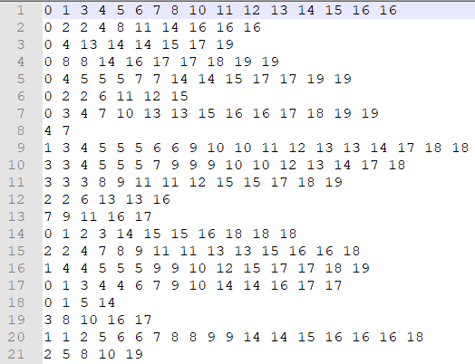

Slide 9
Unstructured Data

Slide 10
Data Models – Unstructured data
Some data may have no structure at all:
There is no apparent structure to this data.
Nor any clues to what the figures may mean.
Very hard to give meaning to this data!

Slide 11
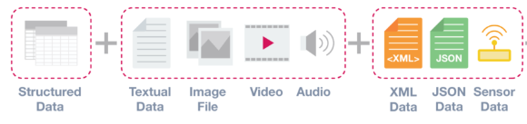

Slide 12
Data Models
It helps to know what structure the data is in.
Helps determine how the data could be stored or manipulated
Data models also determine:
  What operations can be carried out
    E.g., numerical or data functions
  What constraints can be added
    E.g., Today’s date minus the DOB must be greater than 18
Structured data can be held in a relational database
Need something different for semi-structured or unstructured data.
This is where NoSQL database are becoming popular for handling semi-structured data.

Slide 13
NoSQL
Increasingly used to manage a variety of data types in big data.
These data stores are databases that do not represent data in a table format with columns and rows as with conventional relational databases.
Examples of these data stores include Cassandra, MongoDB, etc.
NoSQL data stores provided APIs to allow users to access data.
These APIs can be used directly in an application that needs to access the data.

Slide 14
Types of NoSQL Databases
There are four main types of NoSQL databases:
  Key-Value Databases
  Document Databases
  Column family stores
  Graph Databases

Slide 15
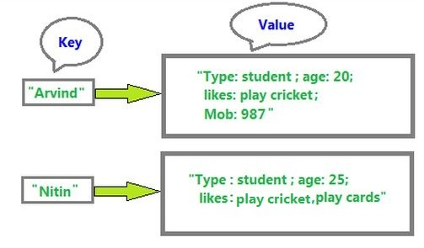
Key Value Databases
Key-value stores are the simplest NoSQL data stores to use from an API perspective.
The client can either get the value for the key, put a value for a key, or delete a key from the data store.
A key-value database is a type of non-relational database that uses a simple key-value method to store data.
A key-value database stores data as a collection of key-value pairs in which a key serves as a unique identifier
Used to store browsing information and shopping cart information. Example: AWS DynamoDB

Slide 16
Document Databases
The database stores and retrieves documents, which can be XML, JSON, etc.
These documents are self-describing, hierarchical tree data structures which can consist of maps, collections, and scalar values.
The documents stored are similar to each other but do not have to be exactly the same.
Document databases store documents in the value part of the key-value store
  think about document databases as key-value stores where the value is examinable.
Examples include: MongoDB, CouchDB, etc

Slide 17
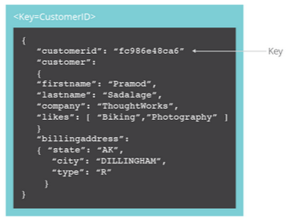

Slide 18
Column Family stores
Column-family databases store data in column families as rows that have many columns associated with a row key.
Column families are groups of related data that is often accessed together.
For a Customer, we would often access their Profile information at the same time, but not their Orders.
The difference is that various rows do not have to have the same columns, and columns can be added to any row at any time without having to add it to other rows
Example: Apache Cassandra

Slide 19
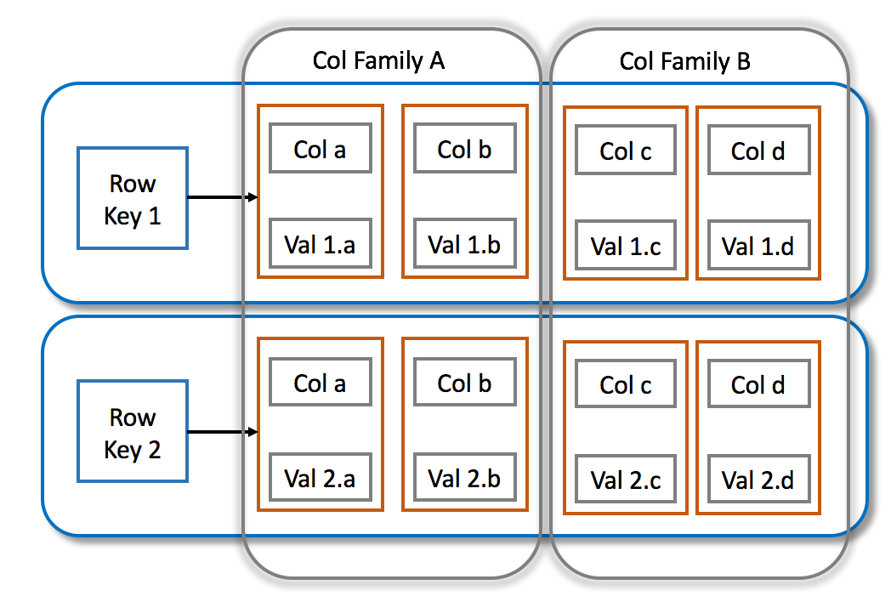

Slide 20
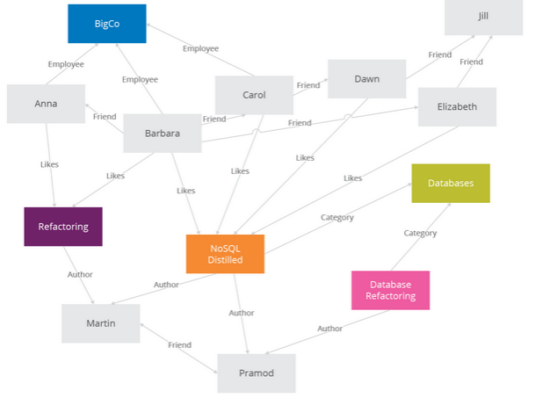
Graph Databases
Graph databases allow you to store entities and relationships between these entities.
Entities are also known as nodes, which have properties.
Think of a node as an instance of an object in the application.
Relations are known as edges that can have properties.
Nodes are organized by relationships which allow you to find interesting patterns between the nodes.

Slide 21
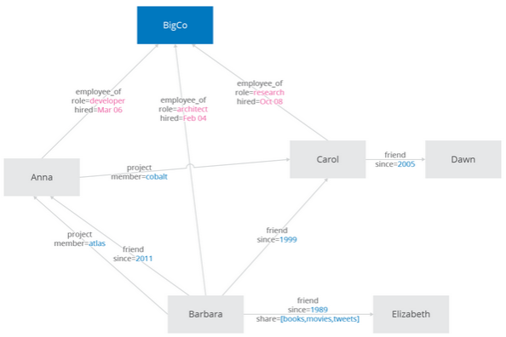
Graph Databases
Nodes can have different types of relationships between them,
For example, things like category, path, or linked lists for sorted access.
Example: InfiniteGraph
Since there is no limit to the number and kind of relationships a node can have, they all can be represented in the same graph database.

Slide 22
Choosing NoSQL database
Some general guidelines (Sadalage 2014):
  Key-value databases
    generally useful for storing session information, user profiles, preferences, shopping cart data.
    avoid using Key-value databases when there is a need to query by data, have relationships between the data being stored or we need to operate on multiple keys at the same time.
  Document databases
    generally useful for content management systems, blogging platforms, web analytics, real-time analytics, ecommerce-applications.
    avoid using document databases for systems that need complex transactions spanning multiple operations or queries against varying aggregate structures.
  Column family databases
    generally useful for content management systems, blogging platforms, maintaining counters, expiring usage.
    avoid using column family databases for systems that are in early development, changing query patterns.
  Graph databases
    well suited to problem spaces where we have connected data, such as social networks, spatial data, routing information for goods and money, recommendation engines
Notes:
http://martinfowler.com/books/nosql.html

Slide 23
MongoDB
A MongoDB database is an example of a document type NoSQL database
It works on the concept of collections and documents:
Collections
  Collection is a group of MongoDB documents.
  However, all documents in a collection should have a similar purpose.
Notes:
https://www.tutorialspoint.com/mongodb/mongodb_overview.htm

Slide 24
MongoDB
Document
  A document is a set of key-value pairs:
  {
  studentno: 1712345,
  studentName: “Anton Du Beke”,
  email: “a.dubeke@wlv.ac.uk”
  }
  Documents have a dynamic schema, which means that documents in the same collection do not need to have the same set of columns or structure.
  {
  studentno: 1754321,
  studentName: “Susan Calman”,
  dob: “11-APRIL-1999”
  email: “s.calman@wlv.ac.uk”
  }
  Common fields in a collection's documents may hold different types of data too.
  {
  studentno: 1754321,
  studentName: { firstName: “Kevin”, surname: “Clifton” },
  email: “k.clifton@wlv.ac.uk”
  }
value
key
DOB is new
studentName now an array

Slide 25
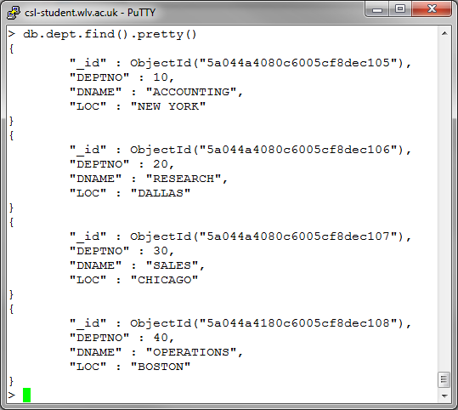
Document v’s Relational Databases
Comparison of terminology in MongoDB (Document database) compared to Oracle (relational database):
Collection
Document
Oracle | MongoDB
Table | Collection
Record | Document
Column | Key
Field | Value
Table
Column
Record (row)
Key
Value
Field (Data item)

Slide 26
Using MongoDB – Collections
If a collection does not exist, MongoDB will automatically create the collection when you first store data for that collection.
You can create one in advance, if you want to set any parameters, such as the maximum size.
To create a new collection:
  db.createCollection('depts', {max: 20})
  This creates a collection called depts that can hold a maximum of 20 documents.
To show what collections you have:
  show collections

Slide 27
Using MongoDB – Documents
Data is stored as BSON documents in a collection.
  BSON is a binary representation of JSON documents.
JSON is built on two structures:
  A collection of name/value pairs
  An ordered list of values, such as an array
  See http://www.json.org/ or http://bsonspec.org/ for further details
To add new data, involves the use of the INSERT command:
    db.collectionName.insert( {
    key1: 'value1',
    keyN: valueN } )
This is similar to an INSERT statement in SQL, where the collectionName would be the table and the key is the column and the value is the data to be stored.
For example (SQL):
  INSERT into collectionName (key1, keyN)
  VALUES (‘value1’, ‘valueN’);

Slide 28
MongoDB – Documents
Unlike the relational model, you do not need to define a schema in advance for our documents, with the equivalent of a CREATE TABLE statement.
In fact the structure of the document can change from one document to another.
This is why it is referred to as being schema-less.
In reality, most collections would contain documents of a similar type, e.g., a collection of student information.

Slide 29
Object Ids
MongoDB creates a unique object id for objects in the database.
For example:
  db.dept.find().pretty()
Will show an object id for each department document, along the lines of:
  "_id" : ObjectId("58245944d6473dc2e8d23a26")
  See slide 19 for other examples
This is a system generated, but you can define your own object ids too (like a primary key)
For example:
  db.projCollection.insert( {
  _id: 10,
  projno: 110,
  proj_name: 'Oracle Project',
  budget: 10000 } )
db.projCollection.insert( {
projno: 140,
proj_name: 'ObjectId Project',
budget: 25000 } )
Or omitting an _id generates a system id

Slide 30
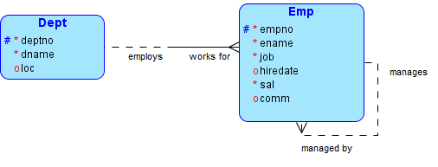

DEPT/EMP schema
Taking our DEPT/EMP scenario:
and data:

Slide 31
Collection Example: Dept
To create the equivalent of our Dept table:
    db.dept.insert( [
    {
    _id: 10,
    deptno: 10,
    dname: "ACCOUNTING",
    loc: "NEW YORK"
    } ,
    {
    _id: 20,
    deptno: 20,
    dname: "RESEARCH",
    loc: "DALLAS"
    ] })
Use square brackets to add more than one record
Object identifier
Character data must be in double quotes

Slide 32
Collection Example: Emp
Add some employees:
  db.emp.insert( [
  {
  empno: 7876,
  ename: "ADAMS",
  job: "CLERK",
  mgr: 7788,
  hiredate: "19-NOV-2015",
  sal: 1100,
  deptno: 20
  },
  {
  empno: 7499,
  ename: "ALLEN",
  job: "SALESMAN",
  mgr: 7698,
  hiredate: "20-FEB-1995",
  sal: 1600,
  comm: 300,
  deptno: 30
  }
  ])
Note we have not defined any object IDs this time.

Slide 33
Queries
Collections can be queried using the find() method.
The basic syntax is:
    db.collectionName.find()
This will return the data in an unstructured way.
To improve this, use the pretty() method:
      db.collectionName.find().pretty()
For example:
    db.dept.find().pretty()

Slide 34
find()
find() can also contain parameters to restrict what data is returned
  Similar to the WHERE part of a SQL statement
For example, to find the Sales department details:
  db.dept.find({dname:"SALES"})
Produces:
  { "_id" : 30, "deptno" : 30, "dname" : "SALES", "loc" : "CHICAGO" }
Find the employees in department 30:
  db.emp.find({deptno:30})
Can use pretty() afterwards:
  db.emp.find({deptno:30}).pretty()
Note the difference in _ids values

Slide 35
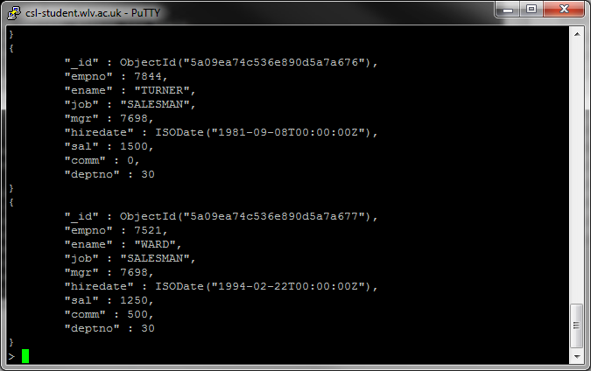

Slide 36
find()
Note, everything is case sensitive!
  The following will return nothing:
    db.dept.find({DNAME:"SALES"})
    db.DEPT.find({dname:"SALES"})
    db.dept.find({dname:"sales"})
  And these will return an error message:
    DB.dept.find({dname:"SALES"})
    db.dept.FIND({dname:"SALES"})
column names can be in double quotes too:
  db.dept.find({"dname":"SALES"})
Notes:
db.dept.find({DNAME:"SALES"}) – DNAME in capitals
db.DEPT.find({dname:"SALES"}) – DEPT in capitals
db.dept.find({dname:"sales"}) – sales in lower case
DB.dept.find({dname:"SALES"}) – DB is not recognised
db.dept.FIND({dname:"SALES"}) – FIND is not a function

Slide 37
Conclusion
NoSQL
  Lots of different types of projects.
  Many of the examples listed are open-source.
  The fact there is no well-defined definition could lead to its downfall.
  RDBMS could evolve to provide better support for non-structured data.

Slide 38
References
Lecture slides from Level 6 (Big Data) of WLV

